Slide 1
Unlock the value in your legal relationships
BUSINESS PLAN
A START UP PERSPECTIVE
NILEMA BHAKTA-JONES
CEO
Twitter: #
NBJNiloo
www.alacritylaw.com

Slide 2
POPULAR START-UP MYTHS
QUIZ?

Slide 3
You don’t need a business plan
‘Skinny jeans and beards’!
Shoreditch or Silicon Valley?
Lone genius
Lots of cash and funding
It’s cool, exciting and chilled out
Keep it a secret
“He who fails to plan, plans to fail.”
Diversity is critical
Set up anywhere with space
Rare to have a single “AHA” moment
Small funding can make a difference
Default is failure, Risk of ‘burn out’
Use the power of your Network

Slide 4
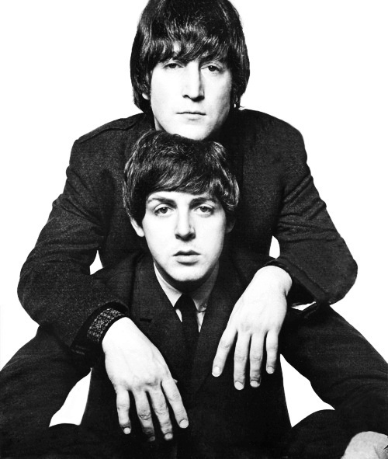
LONE GENIUS IS A MYTH AND RARE
The real heart of creativity is in collective genius
Innovation is an interplay of ideas
Cross functional diverse teams
Permission to fail
Psychologically safe
Creative abrasion involves conflict
Routine does not lead to discovery

Slide 5
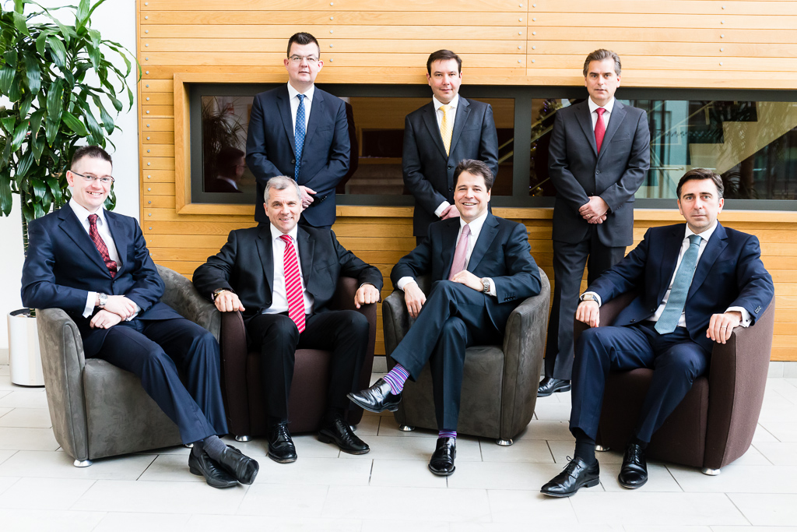
HOW DO YOU PERSUADE A GROUP OF MILLIONAIRES THEIR BUSINESS MODEL IS BROKEN?

Slide 6
INNOVATION IS HARD!

Slide 7
FIRST 100 DAYS BUSINESS PLAN

Slide 8
YOU NEED RUTHLESS FOCUS BE VERY PRECIOUS ABOUT YOUR TIME LEVERAGE YOUR NETWORK WATCH YOUR BURN RATE CONSIDER YOUR WELL BEING

Slide 9
WHY DO WE NEED ONE?
It is a living evolving plan
Not one author
Gives structure to the team
Vision and purpose
Mutual & collective goals
People Matter - incentivise
CEO held accountable to deliver
Communication to investors
Onboard new employees, inspire leadership team
Encourage input from experts
Don’t underestimate rigour & structure, culture matters
Financial governance critical

Slide 10
SET PRIORITIES, GOALS & MILESTONES

Slide 11
WHAT I DID
What’s in it for you & the senior team?
Applies to everything – MVP, Design, Features, Brand etc..
Research, Industry experts & knowledge, competitors, customer segmentation
Experiment, Focus Groups, Test & Validate
Rinse and repeat, personas vital
Don’t give away equity immediately
SHAREHOLDERS AGREEMENT
SIMON SINEK – WHY, HOW, WHAT?
DOES THE PROBLEM EXIST? – IS IT CAPABLE OF BEING SOLVED? – DOES IT RESONATE?
WHAT IS THE SOLUTION?
BUILD THE MVP?
ARCHITECT A TEAM – USE YOUR NETWORK

Slide 12
Unlock the value in your legal relationships
THANK YOU
QUESTIONS?

